Slide 1
RAG CHATBOT FOR EU COMMISSION NEWS
SHRI PRAKASH YADAV
MATRICOLA: D03000084
TEXT MINING FINAL PROJECT

Slide 2

INTRODUCTION
The European Commission publishes lots of news every month, but it’s spread across many articles.
If someone wants a specific detail, they usually have to search through the site and read full articles.
This chatbot makes this easier; you can just ask your question directly and get a clear, fact-based answer from the last month’s news.
This way, the chatbot saves time, avoids hallucinations, and stays grounded in real EU news.

Slide 3
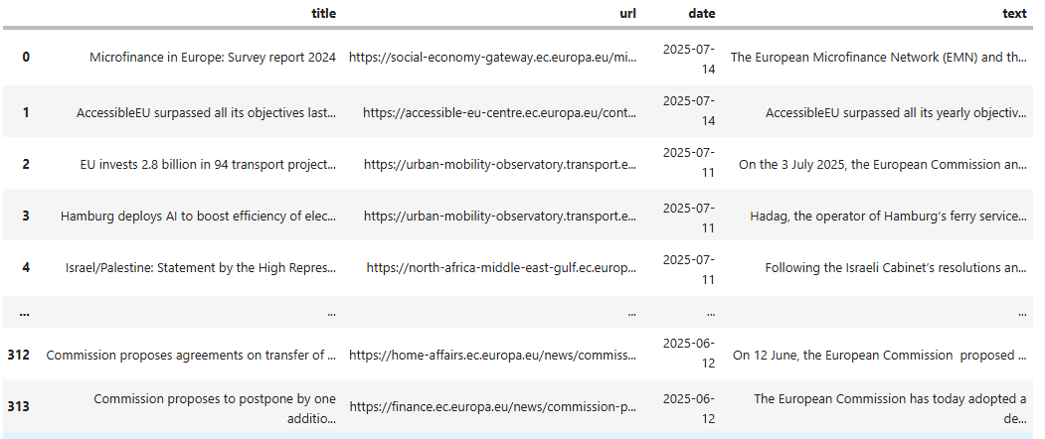
DATA COLLECTION
Scraped European Commission news (June 6 – July 14, 2024).
Removed headers, footers, and duplicates for clean text.
Preserved tables separately using <table> </table> tags to prevent midway chunking.
Stored metadata: title, date, and link for each article.
Filtered for relevant, high-quality entries.
Final dataset: 317 curated articles.

Slide 4
CHUNKING STRATEGY
Explored several strategies:
  Used NLTK’s Punkt to split articles into sentences, then merged adjacent ones if similarity > 0.75 and total length
  < 300.
    Produced readable chunks, but too short and lacking local context or completeness.
  Relaxed merge rule (similarity > 0.50, max length = 500).
    Created larger, more informative chunks.
Similarity models tested for merging:
  all-MiniLM-L6-v2.
  all-mpnet-base-v2: performed better, giving clearer semantic grouping.
Overlap strategy:
  Added overlap to preserve coherence.
  But heavy overlap caused repetition and wasted context budget.
Final adjustment:
  Switched to shorter chunks of 500 characters with a stride of 200.
  Result: Crisper chunks that fit the LLM context better and improved response.
Best results:
  Came from the simplest approach → 500 characters with 200 overlap.

Slide 5
EMBEDDINGS & VECTOR STORE
Embedding Models :
  all-MiniLM-L6-v2 (384-dim): lightweight baseline, fast but lower semantic quality.
  all-mpnet-base-v2 (768-dim): richer semantic space, consistently higher similarity scores.
Chunk Representation:
  Each chunk converted into a dense vector.
  Stored both text + metadata.
Indexing Approaches
  FAISS L2 index (Euclidean distance) tested first, good but less semantic.
  Shifted to FAISS cosine index with normalized embeddings → closer matches for natural language queries.
Normalization:
  Vectors normalized at both indexing and querying steps.
  Ensures inner product ≈ cosine similarity, making retrieval consistent.

Slide 6
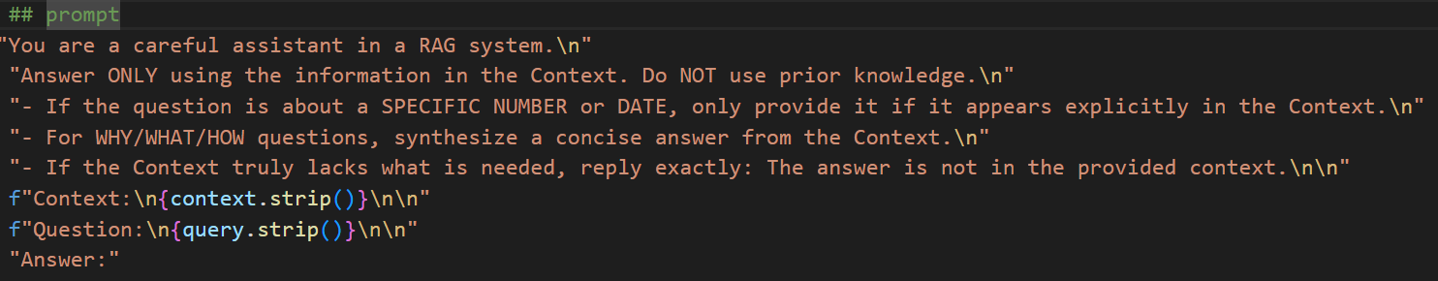
RETRIEVAL & PROMPTING
Retrieval flow:
  User query → embedded with same model (all-mpnet-base-v2).
  FAISS cosine index searched → Top-4 most relevant chunks returned.
  LangChain retriever ensures FAISS ids map back to the right documents.
Prompt construction:
  Retrieved chunks joined into a context block.
  Recent conversation history (last 3 QA) included for continuity.
  Clear instruction: “Answer only from the given context. If answer not found, say you don’t know.”
Grounding:
  Prompts explicitly discourage hallucination.
  Keeps answers short, crisp, and fact-based.
Implementation:
  All wrapped in a Streamlit app with chat-style UI.
  Memory handled with streamlit session_state.

Slide 7
ARCHITECTURE
Embedding
all-mpnet-base-v2
User Querry
Faiss Index
Cosine search
Top 4 Chunks
LLM
Mistral 7B
Prompt
Context+history
Response

Slide 8
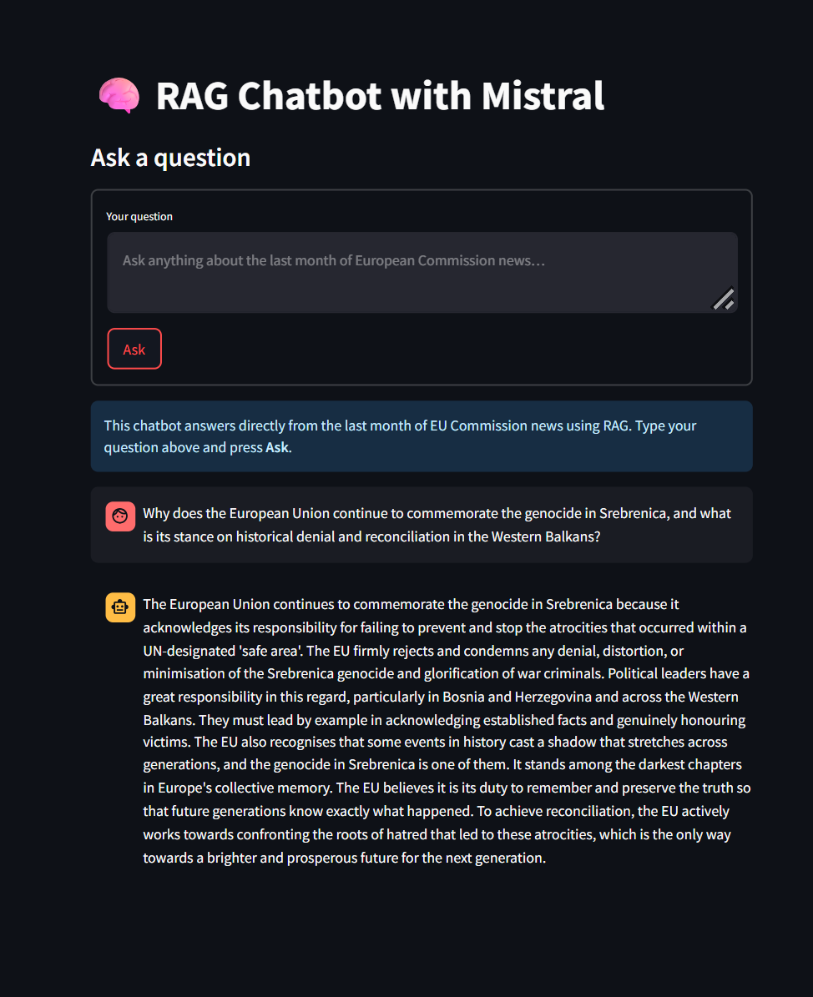
LLM FOR ANSWER GENERATION
Main model used:
  Mistral-7B Instruct via llama.cpp.
  Handles context length up to 8192 tokens.
  Produces fluent, instruction-following answers.
Other models tested
  Phi-2: lightweight, faster but less accurate.
  Gemini 1.5 Flash: strong results, but API quota/latency constraints.
Integration
  Prompt includes: retrieved context + short conversation history + instruction to “answer only from context”.
  Responses are displayed after generation in the Streamlit UI.
Observations
  Mistral: reliable and grounded, but slower on CPU.
  Gemini: almost comparable in accuracy, but impractical locally.
  Final choice: Mistral 7B Instruct for this project.

Slide 9
EVALUATION
Test set: 297 GPT-4o QA pairs.
Metrics: BLEU-1, ROUGE-1/2/L, METEOR, cosine Semantic Similarity.
Setup | BLEU-1 | ROUGE-1 | ROUGE-2 | ROUGE-L | METEOR | Sim
MiniLM + L2 + Mistral7B (Similarity-based merging) | 0.19 | 0.33 | 0.10 | 0.20 | 0.26 | 0.75
MpNet + Cosine + Mistral7B (Similarity-based merging) | 0.22 | 0.38 | 0.13 | 0.24 | 0.35 | 0.88
MpNet + Sliding Window + Mistral7B | 0.27 | 0.43 | 0.17 | 0.29 | 0.39 | 0.84
MpNet + Sliding Window + Gemini | 0.31 | 0.46 | 0.18 | 0.30 | 0.35 | 0.84
Final Setup:
Chunking: 500 characters with 200 overlap.
Index: FAISS cosine similarity
Embeddings: MpNet model
LLM: Mistral-7B Instruct as final chat model

Slide 10
CONCLUSION
Built an end-to-end RAG chatbot for European Commission news.
Pipeline:
• Articles (June–July 2024) → 500-char chunks with 200 overlap.
• Encoded using MPNet embeddings → stored in FAISS cosine index.
• Queries answered by Mistral-7B Instruct with context grounding.
Results:
• Evaluation on 297 QA pairs → clear improvement over MiniLM baseline.
• Sliding-window strategy produced more coherent, fact-based answers.
Strengths: grounded responses, low hallucination.
Limitations: latency on CPU, partial quantitative evaluation.

